Slide 1
2-3-4 Trees

Slide 2
Group Members:
Ubaid Ul Haq 16k-3631
Muaaz Anwar 16k-3628
Muhammad Nabeel Farooqui 16k-3627

Slide 3
What is 2-3-4 Tree?
B-Tree with self -balancing property
Leaf nodes lies on same level
Nodes have at most 4 childs
Nodes have maximum 3 keys and minimum 1 key
Notes:
It is also known as 2-4 trees

Slide 4
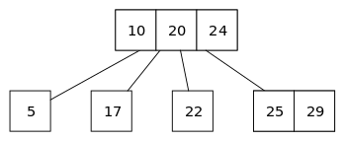
Why 2-3-4 Tree?
Better for large data set
Access time from memory is reduced
Probability of desired data in a node is high
Notes:
2-4 trees are better for larger data set because avl and rbt perform lot of time in rotation for every insertion of data
In 234 trees and other b trees access time to memory for reading and writing is reduced because in these trees every node has more than one value, as compared to other balanced trees like AVL and RBT which have only one value per node. When there are more values in a node then all of them are written and read from the memory at the same time otherwise each node and each value will have to be wriiten and read from memory seperately.
Probability of data which is required is increased because in avl and rbt only one key is stored so to find data it triverse whole tree

Slide 5
Basic Operations
Insert
Delete
Search

Slide 6
Insert

Slide 7
Delete

Slide 8
Search

Slide 9
Time Complexity
 | 2-3-4 Tree | AVL
Search | O(logn) | O(logn)
Insert | O(logn) | O(logn)
Delete | O(logn) | O(logn)
Red-Black Tree
O(logn)
O(logn)
O(logn)

Slide 10
Space Complexity
2-3-4 Tree | AVL
O(n) | O(n)
O(n) | O(n)
O(n) | O(n)
Red-Black Tree
O(n)
O(n)
O(n)

Slide 11
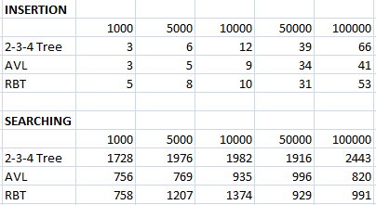
Graphical Analysis
Notes:
Yahan koe animation lagatay hain...

Slide 12
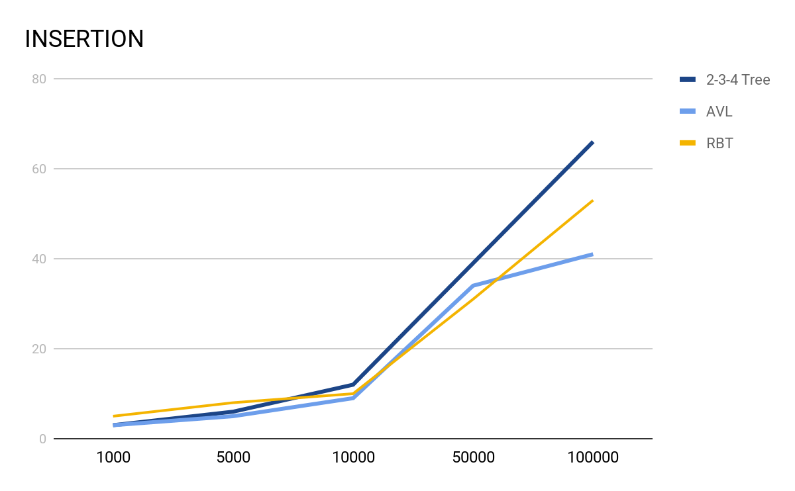
Graphical Analysis

Slide 13
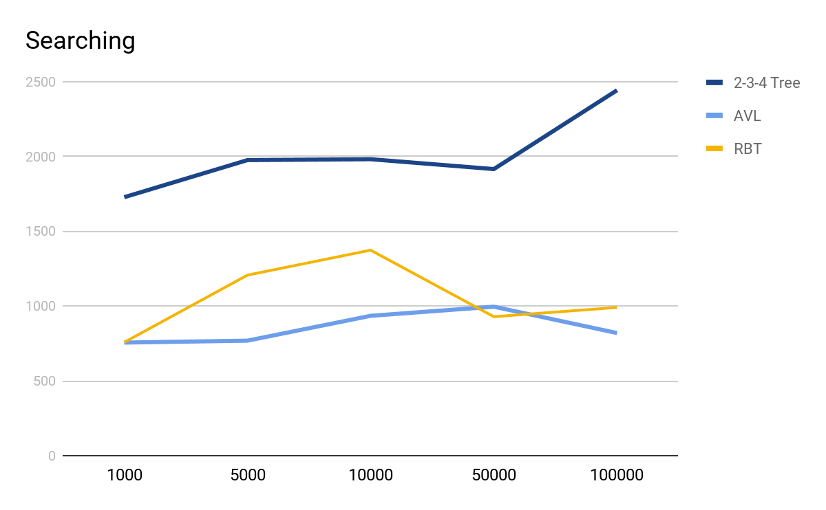

Slide 14
Applications
Dictionary.
Search Engine and Database.
Creating File Server.

Slide 15
Thank You

